Slide 1
CGP Project Proposal
Example

Slide 2
Address core requirements
Animated spotlight
Texture mapping
Grid Ground
Object to track
Tracking Camera
Fly-by? Or draw frames or describe more complex behaviour
Fog use

Slide 3
Supply details
Texture map images you will use
Mesh (obj – low res) files you will use
Mesh model rendered saved as image.

Slide 4
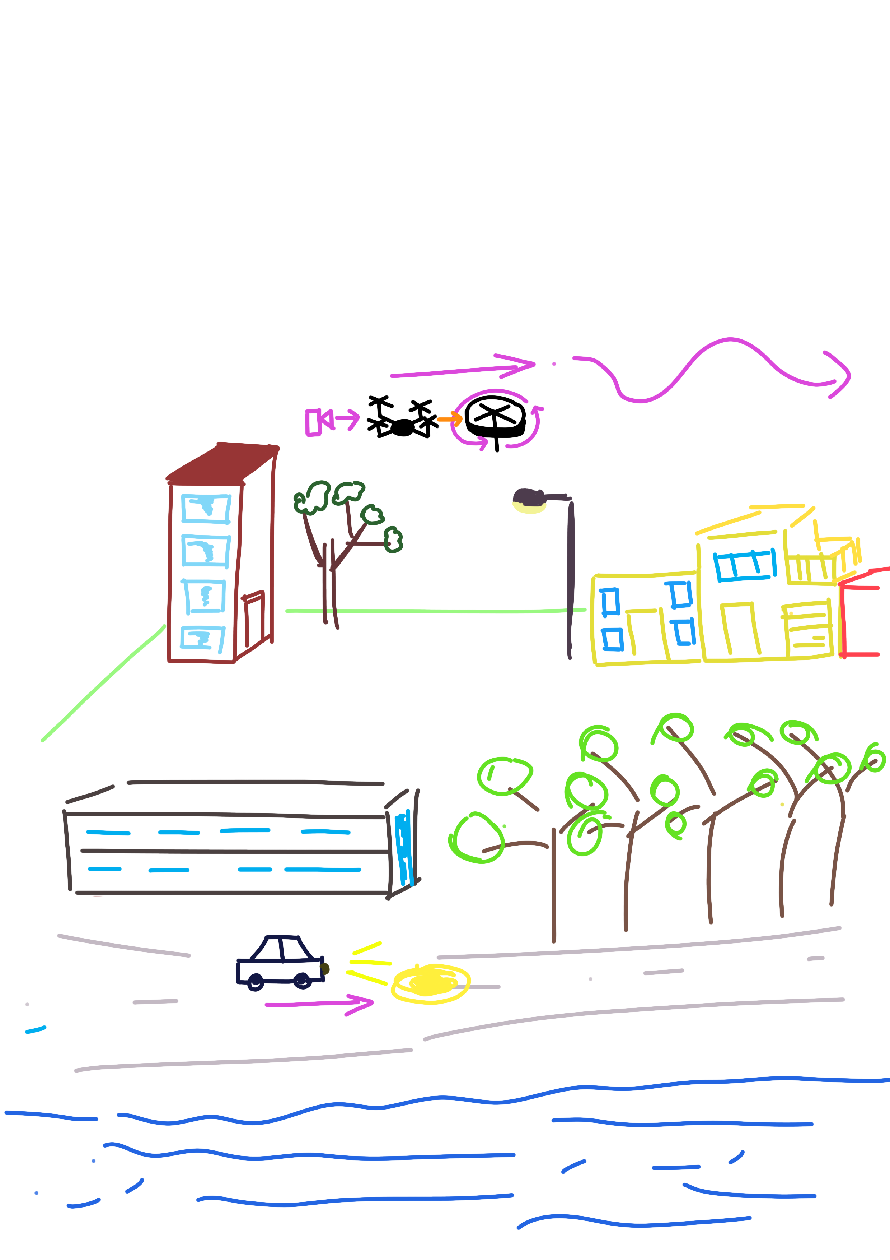

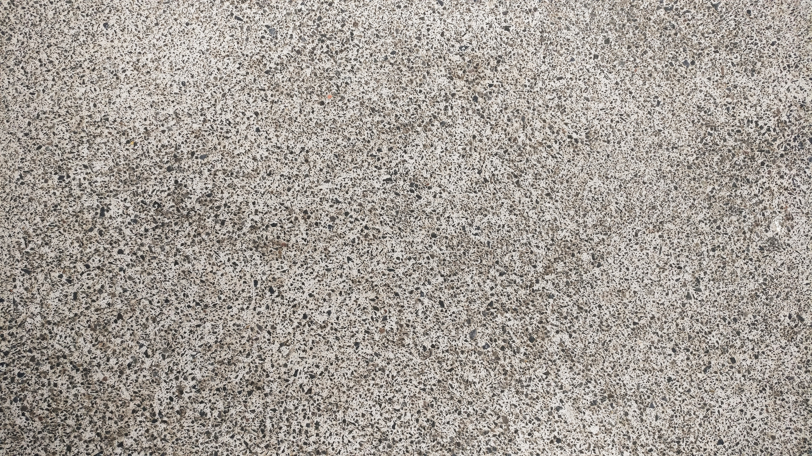

Example
Textures from https://www.pexels.com – CC0 License
free for personal and commercial use, no attribution required
Quadcopter
implemented as hierarchical model
Used for fly by – keyboard controls
Object camera will track and optional top down view (key controlled)
Buildings
Procedural mesh – in display list
Procedural mesh means whole side of building not light and can light it more realistically
Car, also hierarchical model, animated on fixed path, has 2 spotlights attached that light the road surface
Terrain is a flat gird of squares divided into regions, regions texture mapped differently (road, sea, grass). Water texture rendered with some transparency.
Fog – as scene at night dark fog used to enhance night time effect so not just lights
Trees – mesh model low res obj files with materials

Slide 5
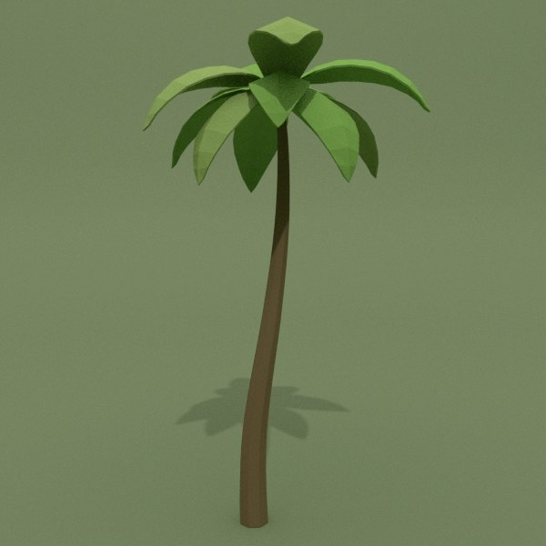
Obj file
Tropical palm by by Zerkalo_TMY from Carrot & Crystal 3D model
Low res
Royalty Free from www.turbosquid.com

